Slide 1
CONTEMPORARY INDIA AND EDUCATION B.Ed., I Year B. JANAKIRAMAN M.Sc., M.Ed., M.Phil., SLET(Edn) ., (Ph.D) Assistant Professor, Subham College of Education, Madurantakam.

Slide 2
Policy Frameworks on Education: Pre-Independent India
Vedic System of Education
Buddhist System of Education

Slide 3
Objectives of Vedic Education
Physical and Intellectual development
Teacher Centered
Religious and Spiritual
Knowledge the third eye
Not Merely book learning
Preservation and Spread of Culture
Development of Character and Personality

Slide 4
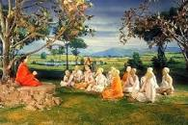
Vedic System of Education
Vedas are known as ‘Sruthi’. Sruthi means those which are directly heard and they are divine revelations.
The term ‘Veda’ means Knowledge or Wisdom
Basic Vedas : There are four Types,
1. Rig Veda
2. Yajur Veda
3. Sama Veda
4. Atharvana Veda

Slide 5
Vedanthic Education
Aims of Education
The spiritual personality is the central core of the Vedantha Philosophy. In education we have to ‘Respect the individual personality’ as the object of transformation.
Education should help pupils for their self-realisation.
Development of personality.
2. Curriculum
The Vedic curriculum consisted of the learning of Vedas, Upanishads, Siksha, Kalpa, Vyakarna, Niraktha, Chanda and Jyothisha.
Study of classics like Ramayana and Mahabaratha.

Slide 6
Vedanthic Education
3. Gurukula System of Education
Children had to spend their students days, called ‘Brahmacharya’ at the residence of the ‘Guru’ called ‘Ashram’, which were generally located on the outskirts of towns.
All facilities like free food, clothes and stay were provided in the Ashram.
4.Method of Teaching
Saravana- Listening of text
Manana- Reflection on their meaning
Nididyasana- Meditation as the methods to master knowledge.

Slide 7
Teacher –student’s relationship
Every student was required to serve his teacher compulsorily.
The students obeyed the guru, any violation of Guru’s instructions give punishment.
Guru had full autonomy.
Teacher centered Education.
Lecture method is used.
Sanskrit language used.

Slide 8
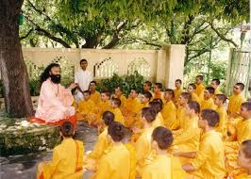
Role of Teacher
Teacher influenced the learner through his life method.
Teacher was considered as the spiritual father of the students.
Teachers are higher calibers.
Teacher possessed high moral character.

Slide 9
Discipline in Vedic system
Students were promoted to maintain self discipline through life.
Punishment were given for indiscipline.
Schedule were maintained to reduce the incidence of interpersonal conflicts and indiscipline.
Compulsory Brahmacharya.

Slide 10
Merits of Vedic Education
Education was free for all Eligible learners.
Teaching-learning process took place in natural surrounding.
Pupils lived in a simple and pure life of ‘Brahmacharya.’
Teachers commanded high respect and dignity from all the sections of the society.
All pupils were treated alike irrespective of their social status.

Slide 11
Demerits of Vedic Education
Education was provided only to Brahmins, Kshatriyas and Vaisyas and denied to Sudhras.
Women Education was not given any importance.
Medium of instruction was Sanskrit.
Some considered the service rendered by pupils in the household activities of the teacher, as slavery.
Vedas were given undue importance in the curriculum.

Slide 12
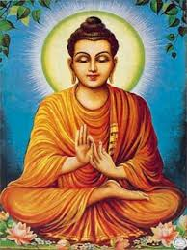
Buddhist system of Education
Bhudhhism , the religion founded by Lord Buddha, who was born in India in the 6th Century B.C.
The three works are
‘Suttas’ (utterances)
‘Vinaya’ (rules of discipline)
‘Abhidhamma’ (Philosophical discussion)

Slide 13
The Teachings of Buddha
The four Noble Truths
There is suffering
There is a cause of suffering
There is cessation of suffering
There is a way leading to cessation of suffering (NIRVANA)

Slide 14
PRINCIPLES OF BUDDHISM
Paphajja – Ceremony
Duration - 12 Years
Dress- Yellow Cloths
Language- Palli
Eight fold path of NIRVANA
Right Faith, Resolve, Action, Living,
Speech, effort, Thinking, Concentration

Slide 15
Aims of Education
Development of Personality
Physical and Intellectual development
Religious and Spiritual development
Character building
Promotion of social efficiency and happiness
Presentation of spread of culture

Slide 16
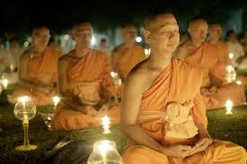
Aims of Education
Development of Personality.
The goal of Buddhist education is to attain wisdom.
Physical and Intellectual development.
Religious and Spiritual development.
Character building.
Promotion of social efficiency and happiness.
Presentation of spread of culture.

Slide 17
Curriculum
The curriculum was spiritual in nature. The aim of Education was to attain salvation. In primary Education 3 R’s ( Reading, Writing and Arithmetic) were taught.
In higher education religion, philosophy, ayurveda, military training etc., were included. Everyone was free to choose his subject without any restriction.

Slide 18
Methods of Teaching
The Core of Buddha’s teaching contains three major points,
Discipline
Meditation and
Wisdom- Wisdom is the goal and deep meditation or concentration in the crucial process toward achieving wisdom.

Slide 19
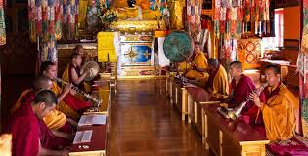
Discipline
Discipline through observing the precepts, is the method that helps one to achieve deep meditation; wisdom will then be realized naturally.

Slide 20
Merits
Students were admitted for education without any discrimination of sex and caste.
Vedas and rituals were denied.
Subjects of human utility like medicine, painting, sculpture, Mathematics and astronomy were given importance.
People’s language of ‘Palli’ was employed as medium of instruction.
Universities were established for higher education.
Budhha Bikshus were the teachers.
Righteous conduct and pure life were stressed.

Slide 21
References
Bhushan, Ritu, Indian History(Ancient Indian History) volume 1,shree publishers &
Distributers, New Delhi,2010,P.52.
2.Nagarajan K (2009),Education in the Emerging Indian Society, Ram Publication, Chennai.
3.Periannan (2016),Contemporary India and Education, Vanitha Pathippagam,Chennai.
4. http://www.accesstoinsight.org/tipitaka/dn/dn.31.0.nara.html
5. http://www.archive.mu.ac.in,op.cit.

Slide 22
Thank you

